Slide 1
RFID BLUETOOTH

Slide 2
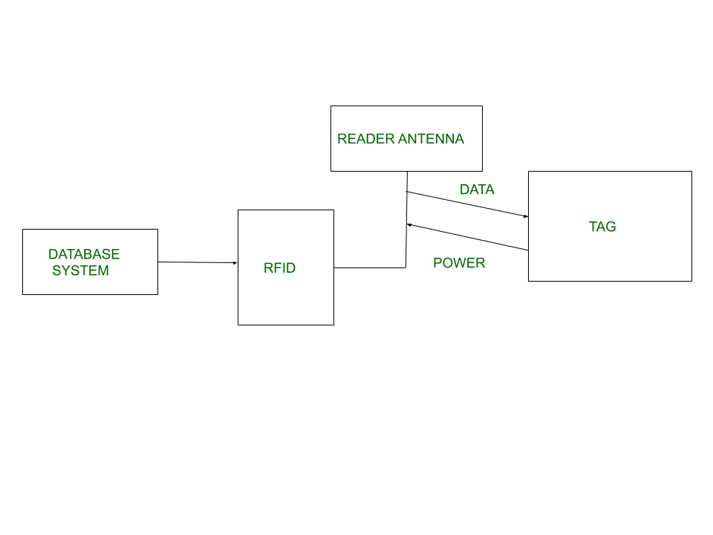
Radio Frequency Identification (RFID) is a form of wireless communication - electromagnetic or electrostatic coupling in the radio frequency portion -identify an object, animal or person.
It uses radio frequency
Data digitally encoded in an RFID tag which might be read by the reader.
This device work as a tag or label during which data read from tags that are stored in the database through the reader as compared to traditional barcodes and QR codes.

Slide 3
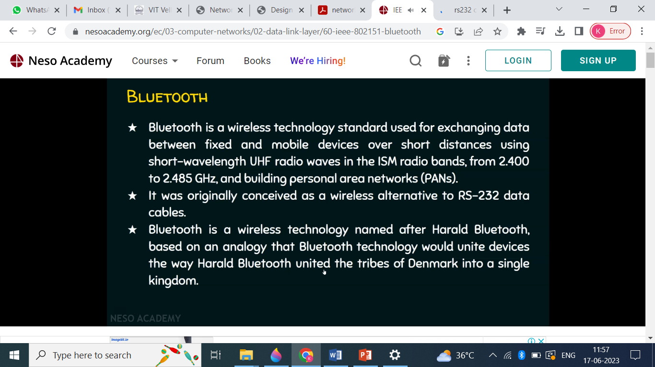

Slide 4
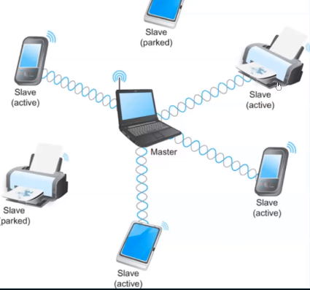
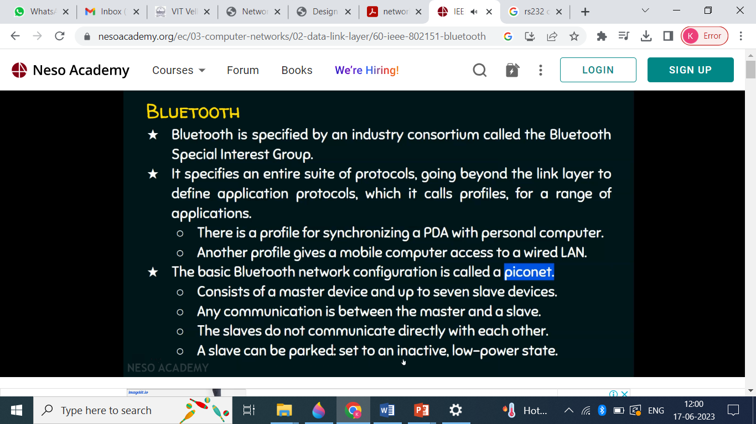
PICONET CONFIGURATION

Slide 5
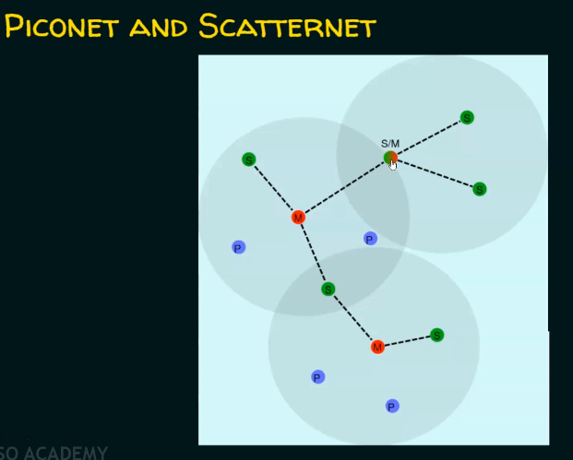
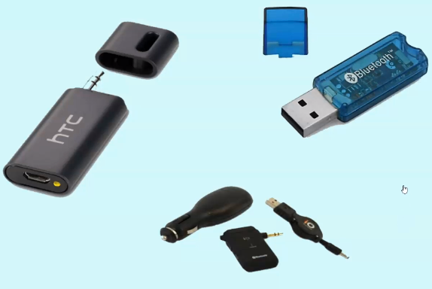

Slide 6
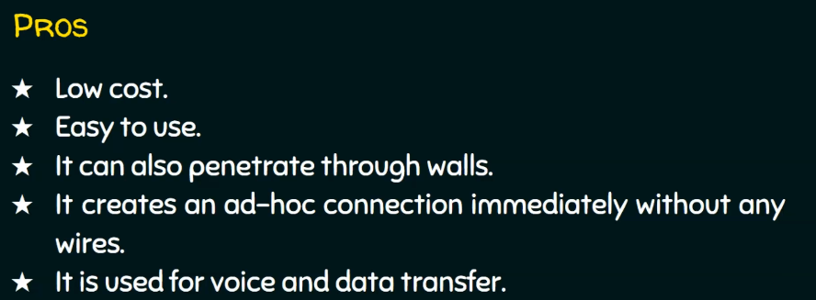
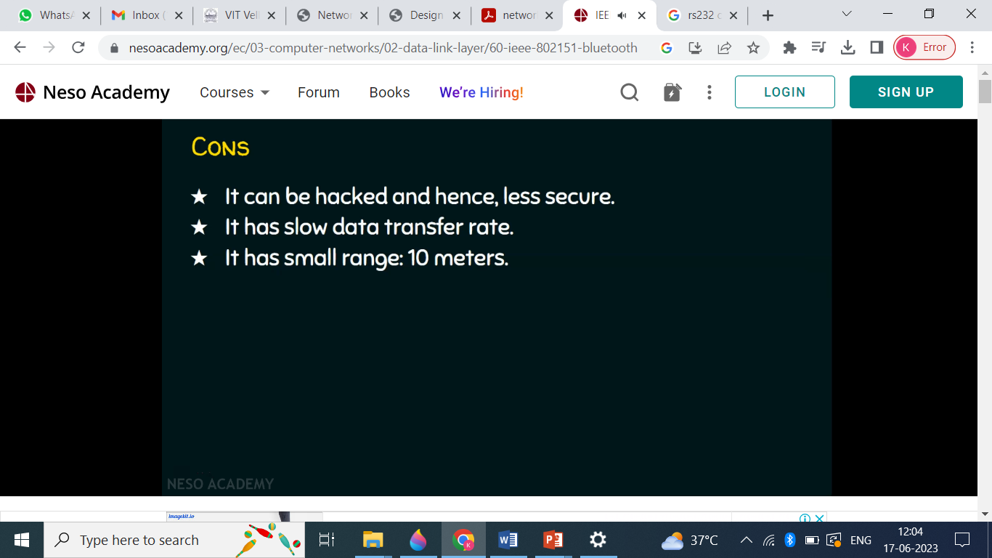

Slide 7
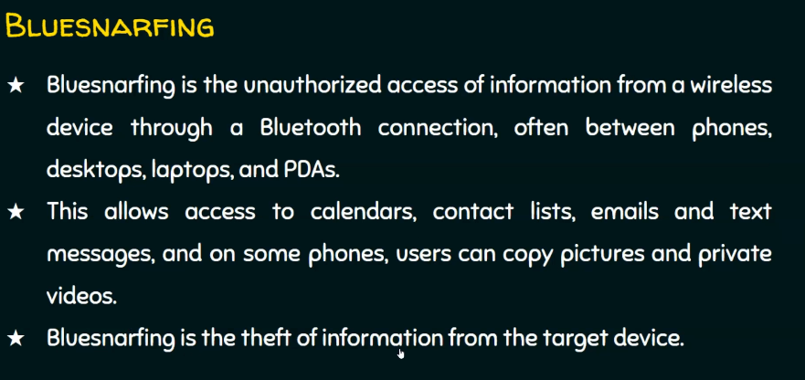

Slide 8
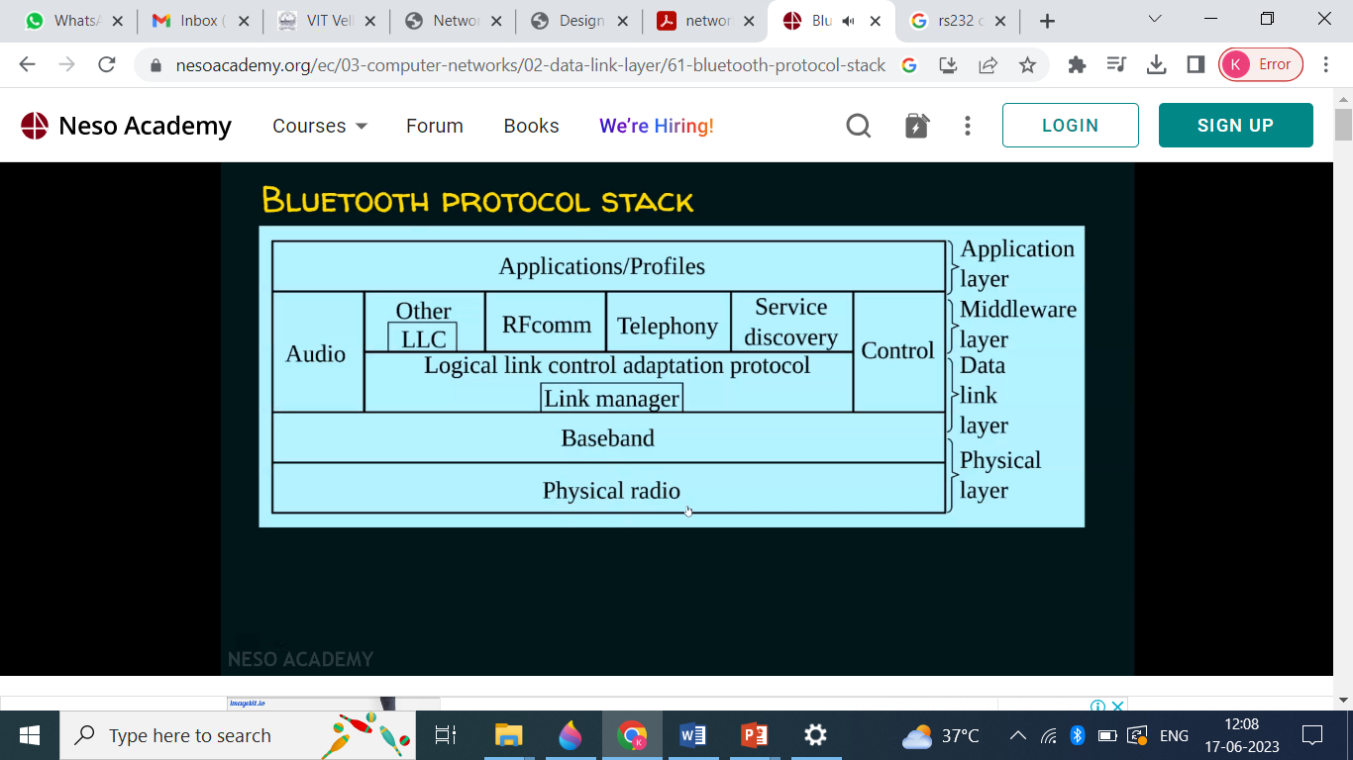
IEEE.802.25.1-Bluetooth
Physical Radio-Transceiver
Baseband-connections of piconet
LM-Already linked devices, authentication,(encryption).
LLC- communication UL & LL(understandable layers-segmentation)
RF-Radio Frontend(interfacing thro wireless
Telephony- voice and data
Service –application interaction

